Slide 1
UCL Earth Sciences
UCAS Open Day
Dr. Pieter Vermeesch
Admissions Tutor
p.vermeesch@ucl.ac.uk
Notes:
This presentation provides a brief overview of the history of UCL and an introduction to the Department of Earth Sciences Department. Please do not hesitate to contact the Admissions Tutor should you have any questions related to the contents of this presentation, or any other aspect of the admissions procedure.

Slide 2
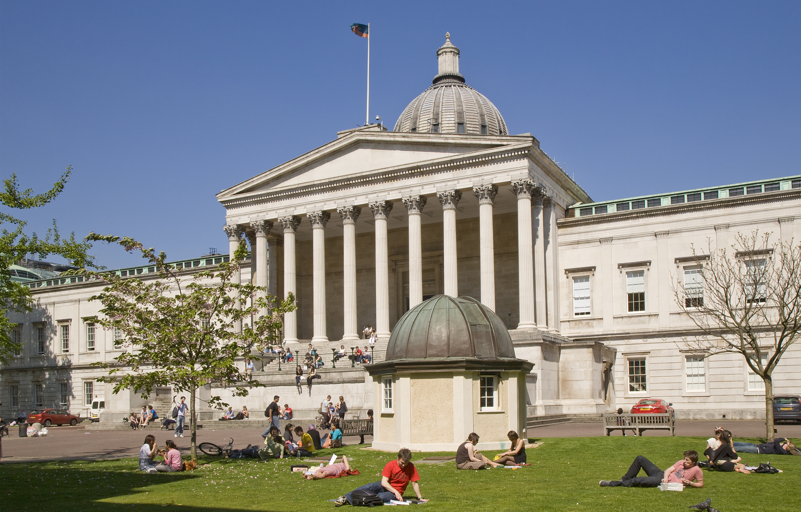
The UCL building is geologically interesting
Notes:
No Earth Sciences Department in the UK (or elsewhere) is made of geologically more interesting building material than UCL. Locked inside the walls of these building are countless of fossils, including dinosaurs.
No Earth Sciences Department in the UK (or elsewhere) is made of geologically more interesting building material than UCL. Locked inside the walls of these building are countless of fossils, including dinosaurs.

Slide 3
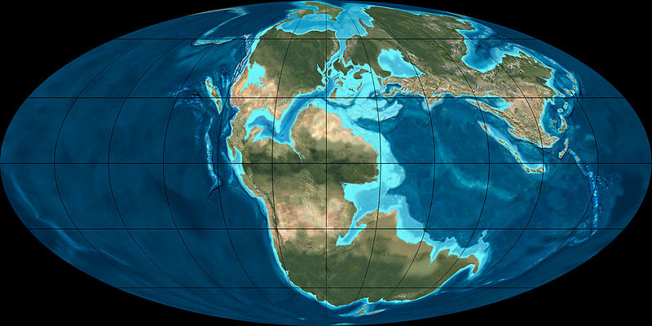
UCL's history goes back 150 million years
Portland
Notes:
150 million years ago, the Earth looked very different from today. During the late Jurassic, all continents were assembled into one supercontinent called Pangaea. In the absence of ice caps, sea level was significantly higher than today. What is now known as England was located considerably further south.
150 million years ago, the Earth looked very different from today. During the late Jurassic, all continents were assembled into one supercontinent called Pangaea. In the absence of ice caps, sea level was significantly higher than today. What is now known as England was located considerably further south.

Slide 4

Jurassic England = the Bahamas today (+ dinosaurs)
Notes:
Climatic conditions were similar to those presently found in places like the Bahamas and Florida. In a shallow sea environment, thick stacks of carbonate rock (limestone) were deposited.
Climatic conditions were similar to those presently found in places like the Bahamas and Florida. In a shallow sea environment, thick stacks of carbonate rock (limestone) were deposited.

Slide 5
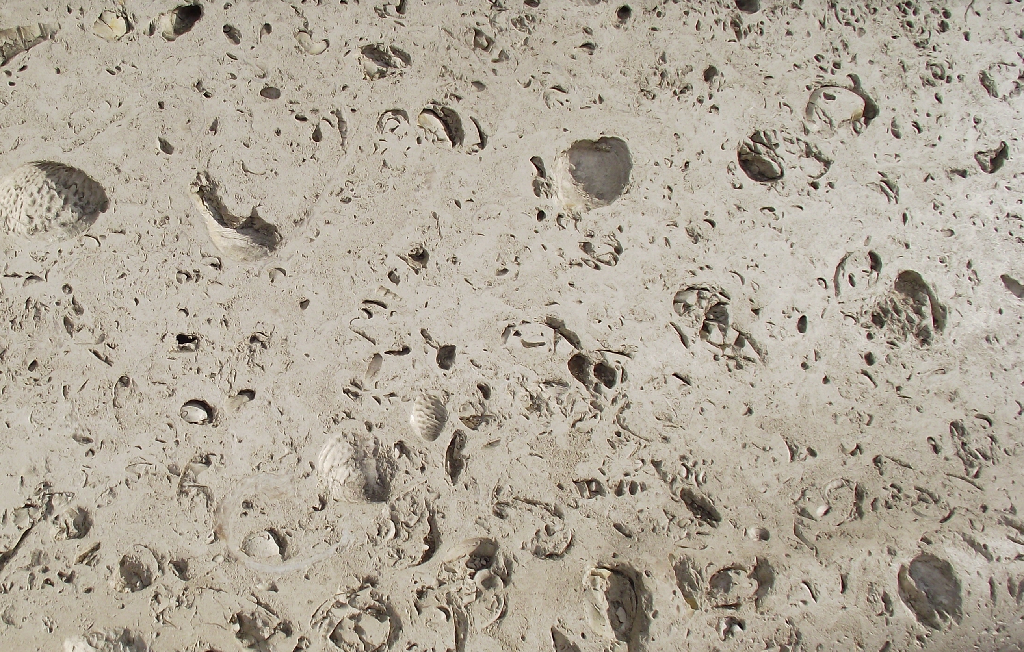
Portland stone
5cm
Notes:
These carbonate rocks contain lots of fossils (gastropods, bivalves, but also occasional dinosaur bones and footprints), and form an excellent building stone which is quarried on the island of Portland (Dorset).
These carbonate rocks contain lots of fossils (gastropods, bivalves, but also occasional dinosaur bones and footprints), and form an excellent building stone which is quarried on the island of Portland (Dorset).

Slide 6
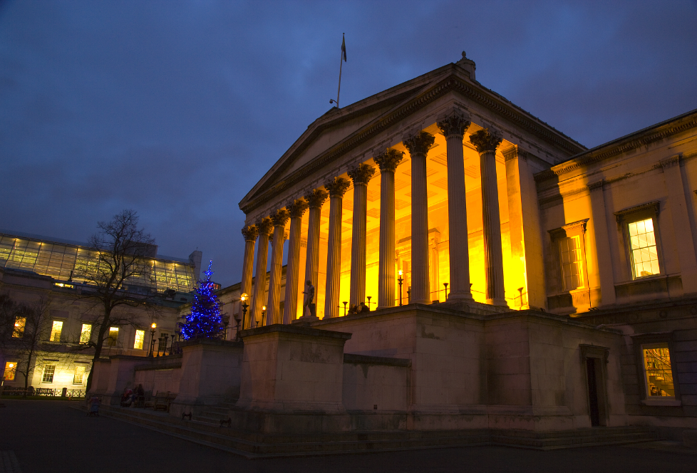
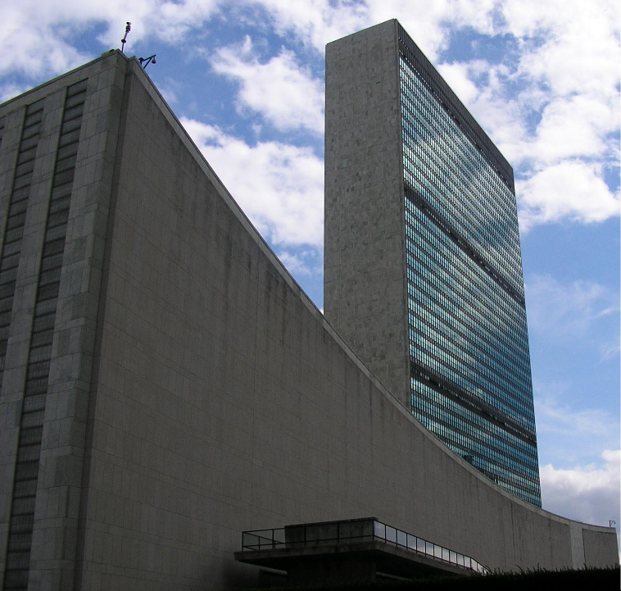
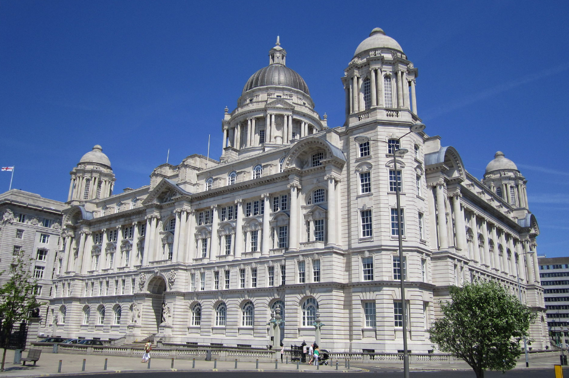
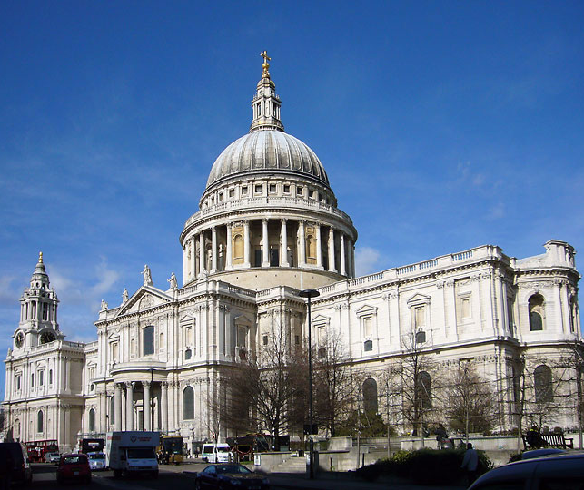
UCL, the UN Building, St Paul's cathedral, Liverpool (clockwise)
Notes:
Portland Stone was used to build UCL, the port authorities building in Liverpool, St Paul's Cathedral and the UN headquarters in New York.
Portland Stone was used to build UCL, the port authorities building in Liverpool, St Paul's Cathedral and the UN headquarters in New York.

Slide 7
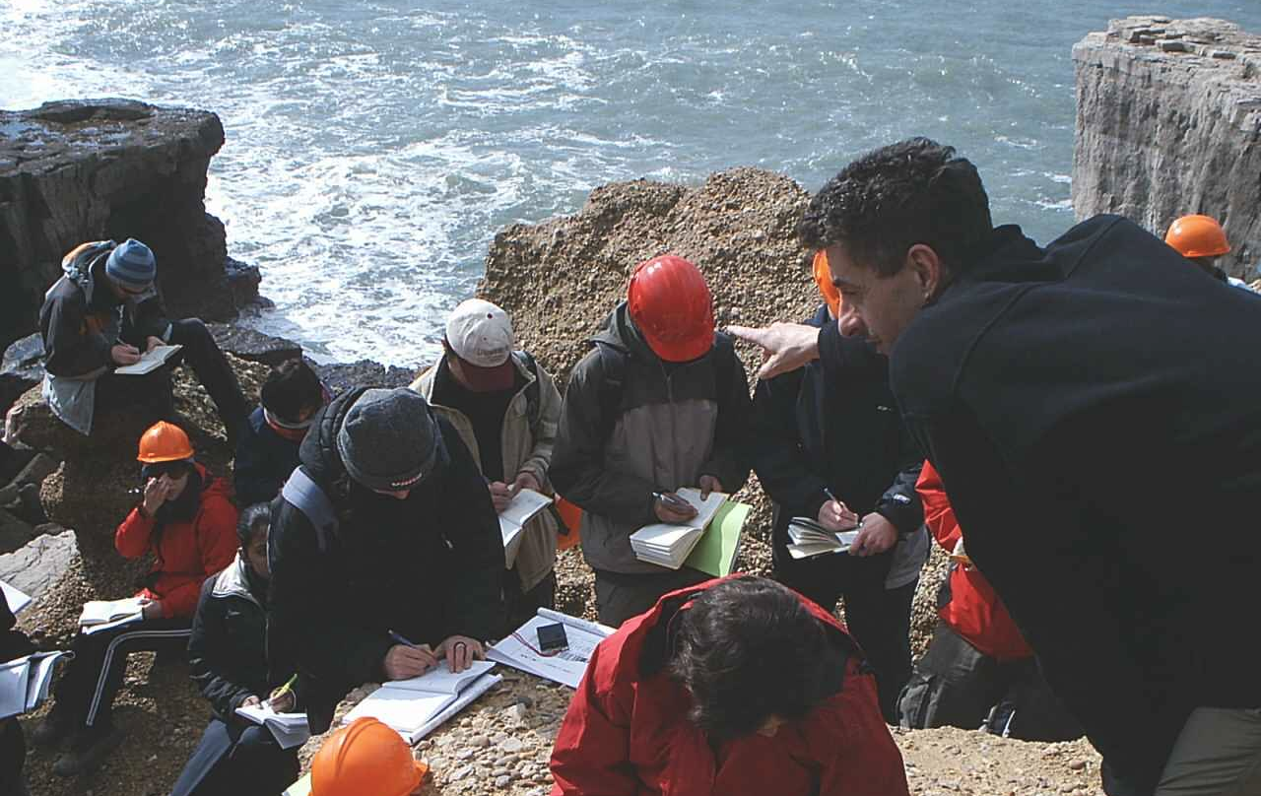
1st year field trip to Dorset, Devon & Cornwall
Notes:
Our first year students visit Portland as part of the Dorset-Devon field trip, as part of the Earth Surface Processes course.
All first year students visit Portland during a field trip to Dorset and Devon, which is part of the Earth Surface Processes course. Field work is an important part of the Earth Sciences curriculum at UCL, as will be discussed in more detail later in this presentation.

Slide 8
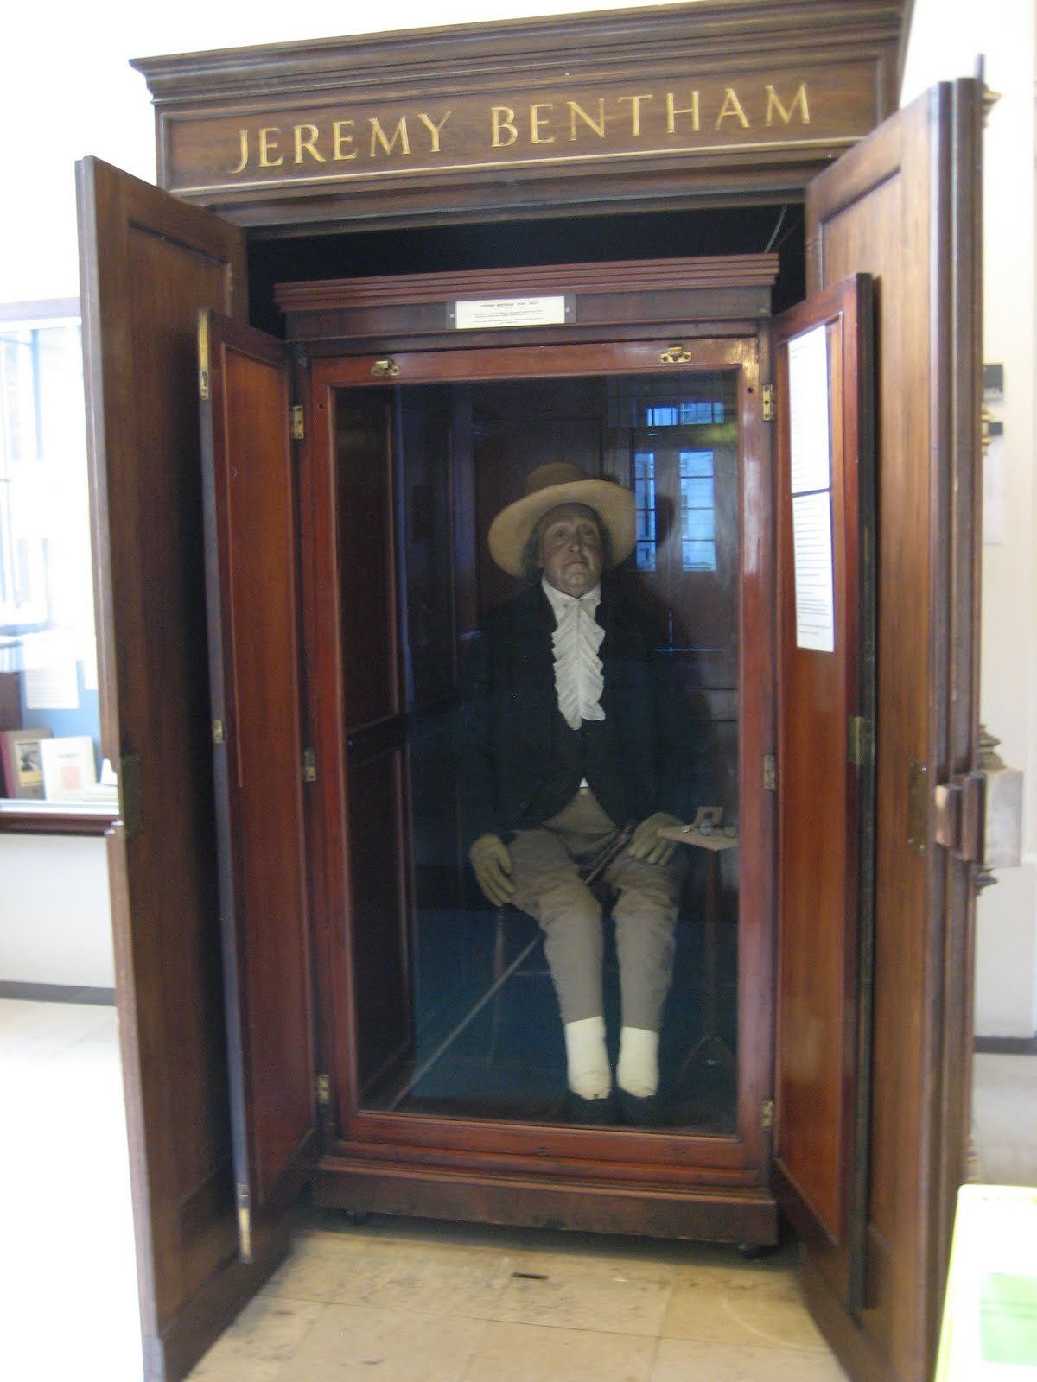
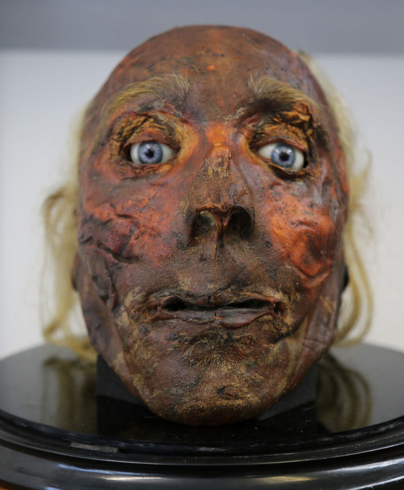
Jeremy Bentham: UCL's spiritual founder
"the greatest happiness of the greatest number"
Notes:
Next, let us move forward in time from 150 million years ago to the year 1826. At that time, England had just two universities, which restricted access to higher education to men of the Anglican faith and a privileged background. A group of London-based intellectuals under the leadership of Jeremy Bentham found this situation unacceptable. Bentham considered Oxford and Cambridge to be "two public nuisances... storehouses and nurseries of political corruption". He proposed to establish a new university which would accept students from any social or religious background. Bentham was a remarkable person. Far ahead of his time, he advocated:
separation of church and state
freedom of expression
equal rights for women
right to divorce
decriminalising of homosexual acts
abolition of slavery
abolition of the death penalty
abolition of physical punishment
early advocate of animal rights
general availability of education
Following his death, and honouring his personal wish, Bentham's body was displayed in the UCL Cloisters as an 'auto-icon'.
Next, let us move forward in time from 150 million years ago to the year 1826. At that time, England had just two universities, which restricted access to higher education to men of the Anglican faith and a privileged background. A group of London-based intellectuals under the leadership of Jeremy Bentham found this situation unacceptable. Bentham considered Oxford and Cambridge to be "two public nuisances... storehouses and nurseries of political corruption". He proposed to establish a new university which would accept students from any social or religious background. Bentham was a remarkable person. Far ahead of his time, he advocated:
-the separation of church and state
-freedom of expression
-equal rights for women
-the right to divorce
-the decriminalising of homosexual acts
-the abolition of slavery
-the abolition of the death penalty
-the abolition of physical punishment
-animal rights
-the general availability of education
Following his death, and honouring his personal wish, Bentham's body was displayed in the UCL Cloisters as an 'auto-icon'.

Slide 9
A place of many firsts
1826 – First university in London, first secular university in England
1828 – First Chemistry department in England
1846 – Robert Lister performs first operation under anaesthesia
1878 – First university to accept women
1892 – Flinders Petrie, the farther of archaeology
1893 – England's first Student Union
1904 – UCL's first Nobel Prize (William Ramsay, Chemistry)
1911 – Karl Pearson founds world's first Statistics Department
1915 – Nobel Prize for William Bragg (Physics)
1973 – UCL is first international link to the internet
2014 – UCL's 29th Nobel Prize (John O'Keefe, Medicine)
Notes:
This slide lists some notable dates in UCL's eventful history. Two points worth expanding are William Ramsay's Nobel Prize for the discovery of the noble gases (He, Ne, Ar), which continue to be the subject of active research in the Earth Sciences as a means of dating rocks (see further in the presentation). William Bragg's Nobel Prize is also important for Earth Scientists, as he developed X-ray crystallography, which continues to be an indispensable tool for mineralogical and petrological research. If UCL were a country, it would rank joint 12th with the Netherlands in terms of Nobel Prizes won.
This slide lists some notable dates in UCL's eventful history. Two points worth expanding are William Ramsay's Nobel Prize for the discovery of the noble gases (He, Ne, Ar), which continue to be the subject of active research in the Earth Sciences as a means of dating rocks (see further in the presentation). William Bragg's Nobel Prize is also important for Earth Scientists, as he developed X-ray crystallography, which continues to be an indispensable tool for mineralogical and petrological research. If UCL were a country, it would rank 6th in terms of Nobel Prizes won.

Slide 10
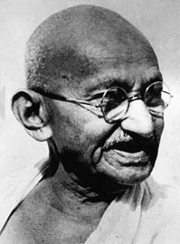
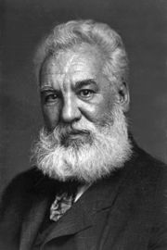
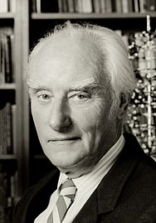
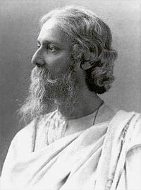
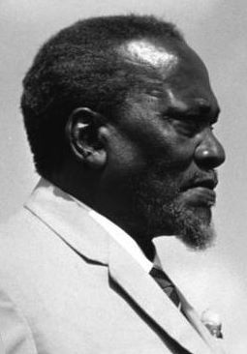
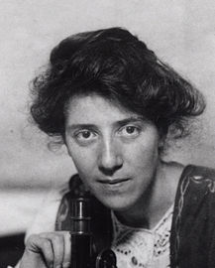
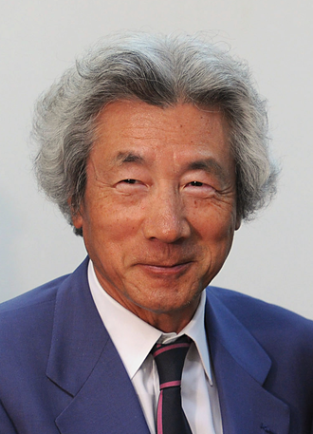
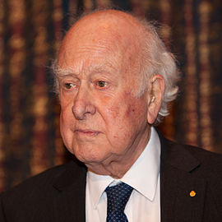
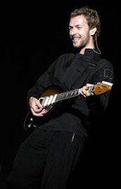
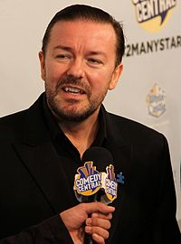
Famous alumni
Gandhi Bell Crick Tagore Kenyatta
Stopes Kuizumi Higgs Martin Gervais
Notes:
A selection of famous alumni:
Mahatma Gandhi
Alexander Graham Bell
Francis Crick (discoverer of DNA)
Rabindranath Tagore (Nobel Prize in literature)
Jomo Kenyatta (first president of Kenya)
Mary Stopes (Earth Scientist, pioneer of birth control)
Junichiro Kuizumi (Prime Minister of Japan)
Peter Higgs (of the boson)
Chris Martin (Coldplay)
Ricky Gervais (aka David Brent)
A selection of famous alumni:
-Mahatma Gandhi
-Alexander Graham Bell
-Francis Crick (discoverer of DNA)
-Rabindranath Tagore (Nobel Prize in literature)
-Jomo Kenyatta (first president of Kenya)
-Mary Stopes (Earth Scientist, pioneer of birth control)
-Junichiro Kuizumi (Prime Minister of Japan)
-Peter Higgs (of the boson)
-Chris Martin (Coldplay)
-Ricky Gervais (aka David Brent)

Slide 11
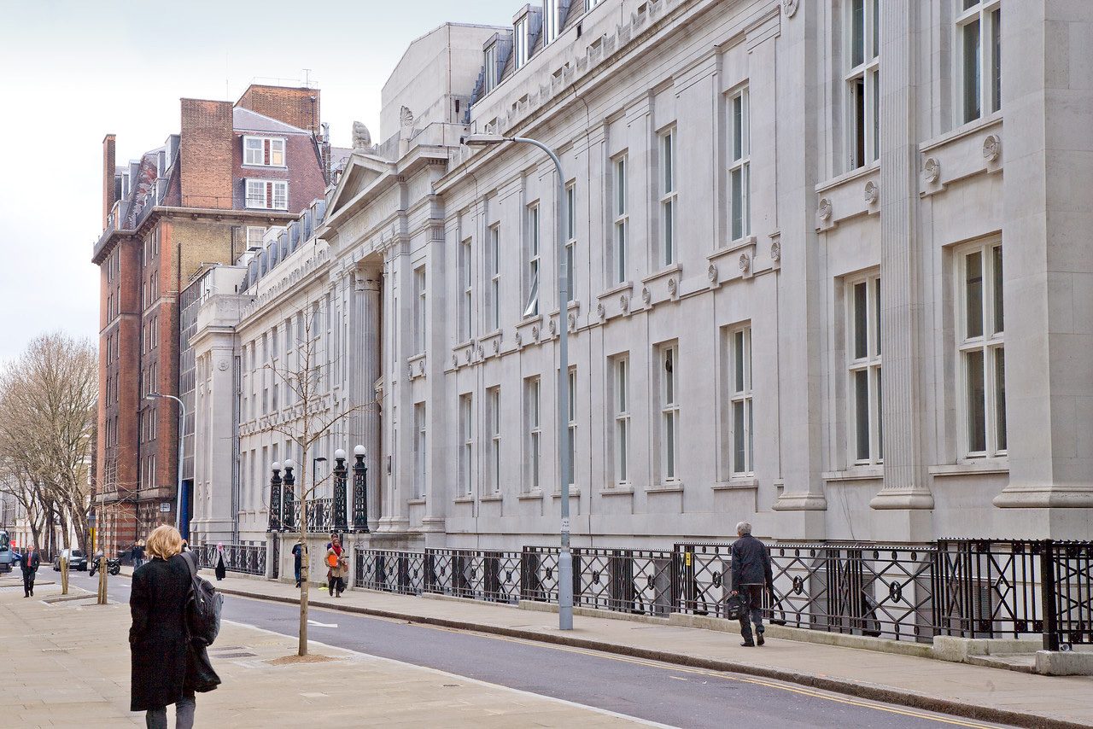
Earth Sciences by numbers
30 staff & 30 research staff and fellows
>40 PhD students
~30 MSc students
~170 undergraduate students
intake ~50 – 60 each year
staff:student ratio = 1:8.5
NSS overal satisfaction: 95%
A-level requirements: AAB
Notes:
With a staff-to-student ratio of 1:6, our Department offers excellent opportunities for our students to interact with lecturers and professors. This is especially the case in years 2-4, when specialised modules are delivered to small groups with close to one-on-one tuition. During the first year, each new student is assigned a Personal Tutor who serves as a mentor during the rest of his/her studies at UCL, providing further personal guidance through the university curriculum.
We admit about 50 students each year, with typical A-level results of AAB, admission depends on A-level/IB subjects, personal statement and other factors. If you are worried that you may not achieve your offer grades, or if you have received an identical offer from a second university and find it difficult to decide which one to choose, then please contact the Admissions Tutor for further information.

Slide 12
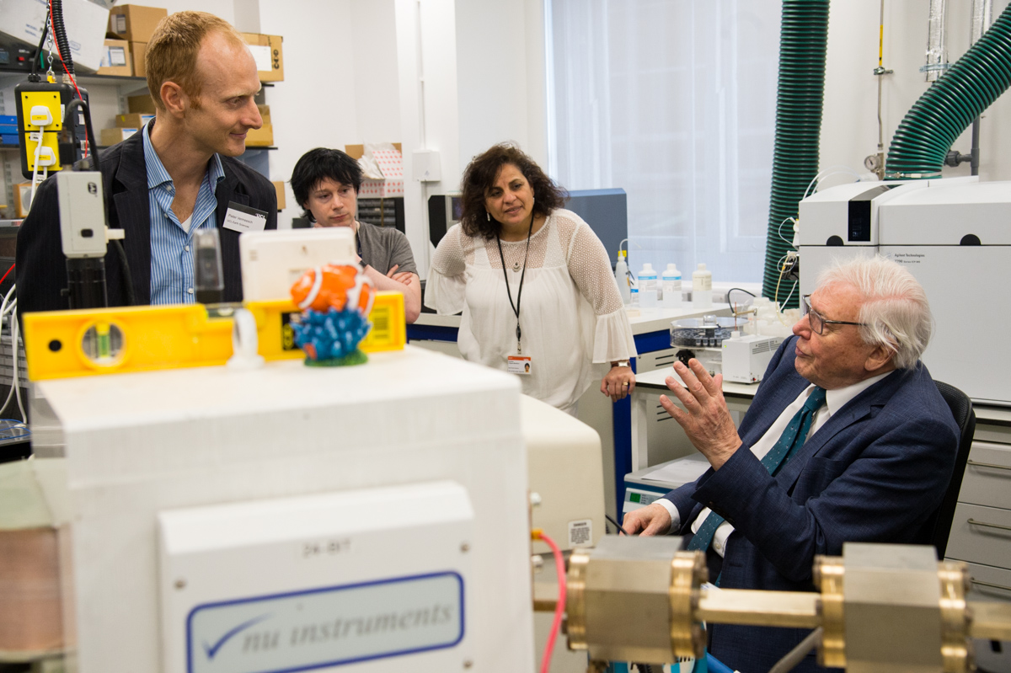
Grand opening by Sir David Attenborough on April 17, 2018.
Notes:
With a staff-to-student ratio of 1:6, our Department offers excellent opportunities for our students to interact with lecturers and professors. This is especially the case in years 2-4, when specialised modules are delivered to small groups with close to one-on-one tuition. During the first year, each new student is assigned a Personal Tutor who serves as a mentor during the rest of his/her studies at UCL, providing further personal guidance through the university curriculum.
The £29M refurbishment of the Kathleen Lonsdale Building has brought all the Earth Sciences staff together under one roof for the first time in over four decades. The refurbished building was officially reopened by Sir David Attenborough on April 17, 2018. The new building has marked a new beginning for the department. This year we have hired five new lecturers, with further hires to be made next year. There is a very positive vibe in the department, so now is an excellent time to come study Earth Sciences at UCL!

Slide 13
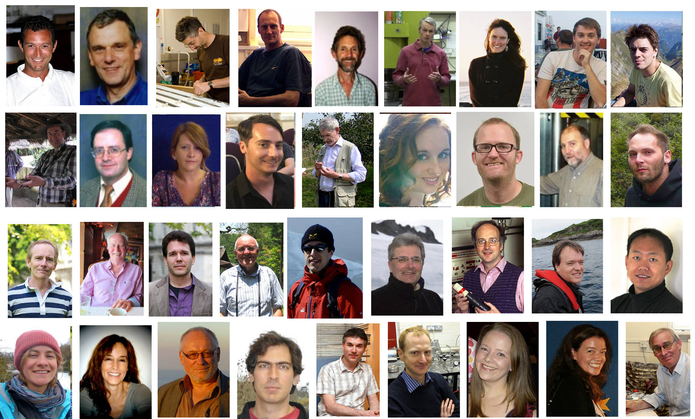
Our academic staff
Notes:
In addition to teaching, all our academic staff are engaged in cutting-edge research, covering every aspect of our planet, from the outermost atmosphere to the inner core. Many of our professors are world authorities in their field and will introduce aspects of their current research in their teaching. At UCL's Department of Earth Sciences, there is no sharp line between teaching and research. To reflect this important fact, the next few slides will introduce our teaching and research activities together.
In addition to teaching, all our academic staff are engaged in cutting-edge research, covering every aspect of our planet, from the outermost atmosphere to the inner core. Many of our professors are world authorities in their field and will introduce aspects of their current research in their teaching. It is in fact a college-wide policy to promote the integration of research and teaching, which is known as the “Connected Curriculum” (http://tinyurl.com/zn2mqvd). To reflect this important fact, the next few slides will introduce our teaching and research activities together.

Slide 14
Degree programmes
Notes:
Our students are divided among 11 degree programmes:
1-2. BSc (3 years) & MSci (4 years) in Geophysics
3-4. BSc & MSci in Geology
5-6. BSc & MSci in Environmental Geoscience
7-8. BSc & MSci in Earth Sciences
9. International Programme in Earth Sciences
10-11. BSc & MSci in Natural Sciences, specialising in Earth Sciences
Natural Sciences students are invited to a separate Open Day, so this programme will not be further discussed in this presentation.
In the next few slides, I will go through the four main degree programmes (Geophysics, Geology, Environmental Geoscience and Earth Sciences), whilst also introducing some of the related research performed in our Department.
Our students are divided among 11 degree programmes:
1-2. BSc (3 years) & MSci (4 years) in Geophysics
3-4. BSc & MSci in Geology
5-6. BSc & MSci in Environmental Geoscience
7-8. BSc & MSci in Earth Sciences
9. International Programme in Earth Sciences
10-11. BSc & MSci in Natural Sciences, specialising in Earth Sciences
Natural Sciences students are invited to a separate Open Day, so this programme will not be further discussed in this presentation. The next few slides will go through the four main degree programmes (Geophysics, Geology, Environmental Geoscience and Earth Sciences), whilst also introducing some of the related research performed in our Department.

Slide 15


Shared modules between all degree programmes
Year 1
Year 2
Earth Materials
The Earth
Geochemistry
Petrology to Petrogenesis
Dynamic Earth
Earth Surface Processes
Global Geophysics
Maps, Images & Structures
Structural Geology & Tectonics
Surface Processes & Structures
Isotope Geology
Principles of Climate
Year 3
Year 4
Earth & Planetary Materials
Physical Volcanology
Tectonic Geomorphology
Environmental Management
Independent MSci Project
Earth & Planetary System Science
Earthquake Seismology
Metamorphic Processes
Crustal Dynamics
Earth Resources & Sustainability
Groundwater Science
Marine Geology
Advanced Geochemistry
Notes:
Although each of the four main degree programmes focuses on different aspects of the Earth, there is a core curriculum of modules that are shared by all degree programmes. The modules shown on this slide are either compulsory or optional. For example, all our students are expected to have a basic training in mineralogy, petrology and geodynamics. Isotope Geology is another discipline which is of general interest to all geoscientists. The next slides provide the briefest of introductions to geochronology, which is an important research field at UCL and, incidentally, the Admissions Tutor's field of research.
Although each of the four main degree programmes focuses on different aspects of the Earth, there is a core curriculum of modules that are shared by all degree programmes. The modules shown on this slide are either compulsory or optional. For example, all our students are expected to have a basic training in mineralogy, petrology and geodynamics. Isotope Geology is another discipline which is of general interest to all geoscientists. The next slides provide the briefest of introductions to geochronology, which is an important research field at UCL and, incidentally, the Admissions Tutor's field of research.

Slide 16
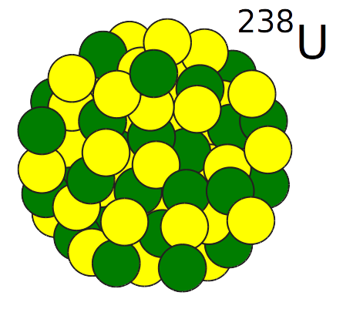
Uranium, the heaviest element in the Solar System
Replace with U, Th
Notes:
Uranium is the heaviest element in the Solar System. Containing 92 protons and 146 neutrons, uranium is simply too heavy to be stable. So over time, uranium falls apart and decays to smaller, more stable elements. This process is called radioactivity.
Uranium is the heaviest element in the Solar System. Containing 92 protons and 146 neutrons, uranium is simply too heavy to be stable. So over time, uranium falls apart and decays to smaller, more stable elements. This process is called radioactivity.

Slide 17
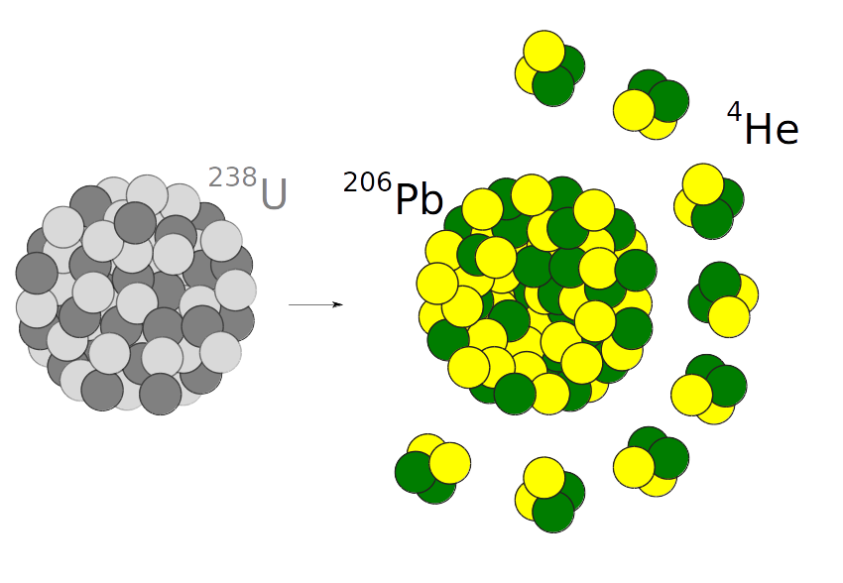
U decays to Pb and He at a precisely known rate
Replace with U, Th
Notes:
Uranium decays to lead and helium (one of the noble gases that won William Ramsay a Nobel Prize). This process happens at a precisely known rate, forming the basis of two geological clocks. The U-Pb clock measures the time elapsed since a U-bearing mineral crystallised. The U-He clock provides a very different kind of information. Helium is the second smallest element in the Universe, and a noble gas. It is not 'happy' sitting in the crystal lattice of a U-bearing mineral and, at high temperatures, will escape. It is only when rocks cool below a certain 'closure temperature' (60-70 degrees C) that the helium gets locked in and that the helium-clock starts ticking. So in contrast with a U-Pb age, a U-He age is not a crystallisation age, but a cooling age. Subsurface temperatures rise at a rate of ca. 30 C/km, and so U-He ages can be used to measure the rate at which rocks are exhumed from 2-3km depths to the surface.
Uranium decays to lead and helium (one of the noble gases that won William Ramsay a Nobel Prize). This process happens at a precisely known rate, forming the basis of two geological clocks. The U-Pb clock measures the time elapsed since a U-bearing mineral crystallised. The U-He clock provides a very different kind of information. Helium is the second smallest element in the Universe, and a noble gas. It is not 'happy' sitting in the crystal lattice of a U-bearing mineral and, at high temperatures, will escape. It is only when rocks cool below a certain 'closure temperature' (60-70 degrees C) that the helium gets locked in and that the helium-clock starts ticking. So in contrast with a U-Pb age, a U-He age is not a crystallisation age, but a cooling age. Subsurface temperatures rise at a rate of ca. 30 C/km, and so U-He ages can be used to measure the rate at which rocks are exhumed from 2-3km depths to the surface.

Slide 18
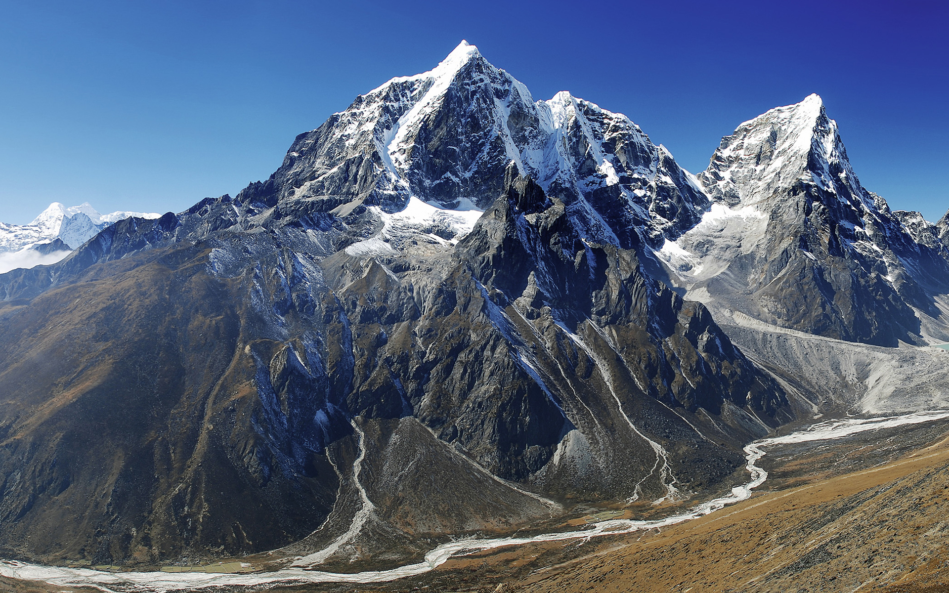
He-ages date cooling
He-age = 5 Myr
He-age = 1 Myr
Notes:
The He/U ratio, and hence the U-He age measured on the summits of high mountains is generally greater than that at the foot of said mountains, reflecting the fact that the summits have cooled through the 60-70 C isotherm before the base. The age difference allows geochronologists to calculate how rapidly mountain ranges are rising due to plate tectonic forces. The London Geochronology Centre (LGC) at UCL is the cradle of this field of geochronology, which is also known as 'thermochronology'.
The He/U ratio, and hence the U-He age measured on the summits of high mountains is generally greater than that at the foot of said mountains, reflecting the fact that the summits have cooled through the 60-70 C isotherm before the base. The age difference allows geochronologists to calculate how rapidly mountain ranges are rising due to plate tectonic forces. The London Geochronology Centre (LGC) at UCL is the cradle of this field of geochronology, which is also known as 'thermochronology'.

Slide 19
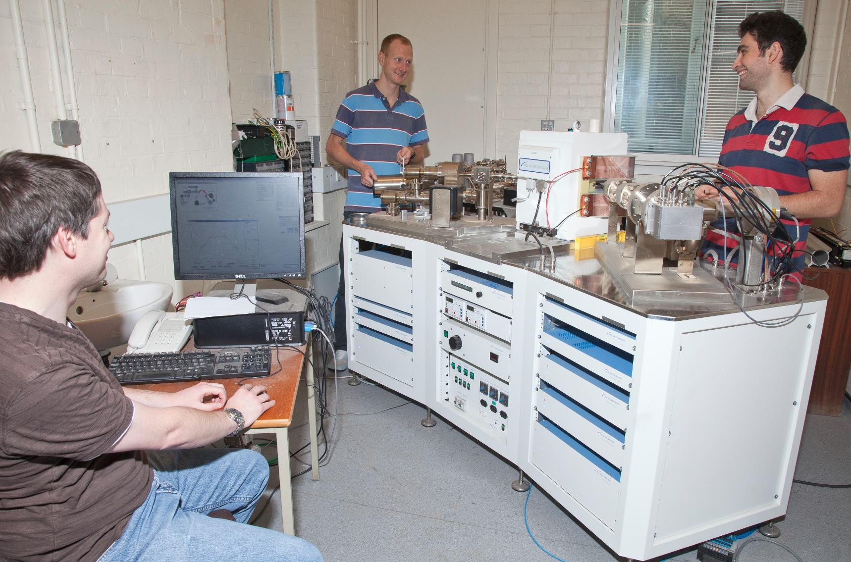
A mass spectrometer at UCL's London Geochronology Centre (LGC)
Notes:
Pb/U and He/U ratios can be precisely measured using sophisticated instruments called 'mass spectrometers', three of which are installed at the LGC.
Pb/U and He/U ratios can be precisely measured using sophisticated instruments called 'mass spectrometers', three of which are installed at the LGC. If you enrol in the 4-year M.Sci. Programme, then you will be required to carry out a research project of your own. If you are interested in geochronology, then you can choose to learn how to operate these machines yourself.

Slide 20
Geophysics
Year 1
Year 2
Global Geophysics
Structural Geology and Tectonics
Maps, Images & Structures
Surface Processes & Structures
Principles of Climate
Isotope Geology
Electricity & Magnetism
Mathematical Methods III
Physics of the Solar System
Numerical Methods for Earth Sciences
Igneous Petrology
Earth Materials
The Earth
From Petrology to Petrogenesis
Dynamic Earth
Surface Processes
Mathematical Methods I
Mathematical Methods II
Classical Mechanics
Year 3
Year 4
Crustal Dynamics
Earth Resources & Sustainability
Groundwater Science
Marine Geology
Advanced Geochemistry
Metamorphism and Metamorphic Processes
Field Geophysics
Seismology I
Ocean Physics and Climate Change
Seismology II
Geodynamics and Global Tectonics
Climate and Energy
Earth & Planetary Materials
Physical Volcanology & Volcanic Hazard
Tectonic Geomorphology
Sustainable Management of the Environment
Earth & Planetary System Science
Independent MSci Project
Earthquake Seismology & Earthquake Hazards
Melting & Volcanism
Deep Earth and Planetary Modelling
Notes:
In addition to the core curriculum shown on slide 15, students of the different degree programmes are also offered many additional modules, tailoring to their specific needs. The Geophysics programme, for example, includes courses taught at the Physics department, as well as advanced courses in Geophysics taught by our own staff. The department has recently hired two young seismologists (Ana Ferreira and Alex Song) who have quickly established a strong research programme in this field at UCL. The following few slides will provide a flavour of this important research field.
In addition to the core curriculum shown on slide 16, students of the different degree programmes are also offered many additional modules tailoring to their specific needs. The Geophysics programme, for example, includes courses taught at the Physics department, as well as advanced courses in Geophysics taught by our own staff. The Department is a globally recognised centre of excellence in Geophysics, built on the expertise of Professors Dario Alfe, John Brodholt, Lidunka Vocadlo and Drs. Maxim Balmer, Nicholas Brantut, Michel Tsamados, Ana Ferreira and Alex Song. The latter two people are experts in the field of seismology, which is the subject of the next few slides. The Geophysics Stream director is Dr. Alex Song (alex.song@ucl.ac.uk).

Slide 21
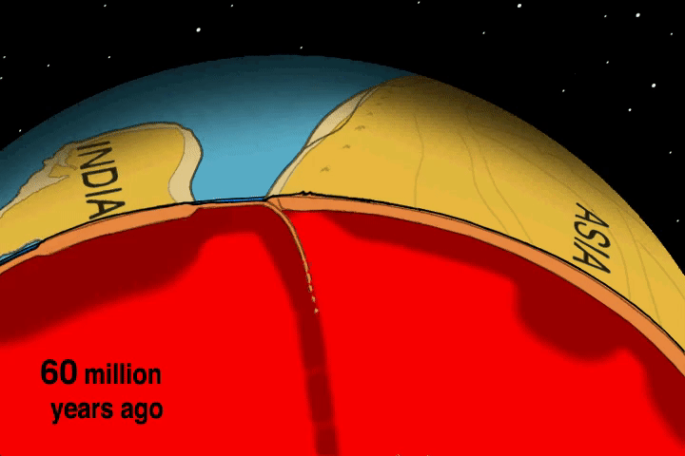
Plate tectonics
Notes:
Plate tectonics is an effective mechanism whereby the Earth loses heat. The Earth is hot on the inside and cold on the outside. When cold oceanic crust becomes denser than the underlying mantle, it eventually sinks into it, much like custard convects in a saucepan when it is heated from below and cooled from the top. Any continental crust attached to a down going slab of oceanic crust will be dragged along with it until it collides with another tectonic plate. Such collisions build mountain belts such as the Himalayas and Alps. Plate movements may appear to be smooth over the million year time scales shown in this animation, but over human time scales, plates move in short bursts, resulting in earthquakes.
Plate tectonics is an effective mechanism whereby the Earth loses heat. The Earth is hot on the inside and cold on the outside. When cold oceanic crust becomes denser than the underlying mantle, it eventually sinks into it, much like custard convects in a saucepan when it is heated from below and cooled from the top. Any continental crust attached to a down going slab of oceanic crust will be dragged along with it until it collides with another tectonic plate. Such collisions build mountain belts such as the Himalayas and Alps. Plate movements may appear to be smooth over the million year time scales shown in this animation, but over human time scales, plates move in short bursts, resulting in earthquakes.

Slide 22
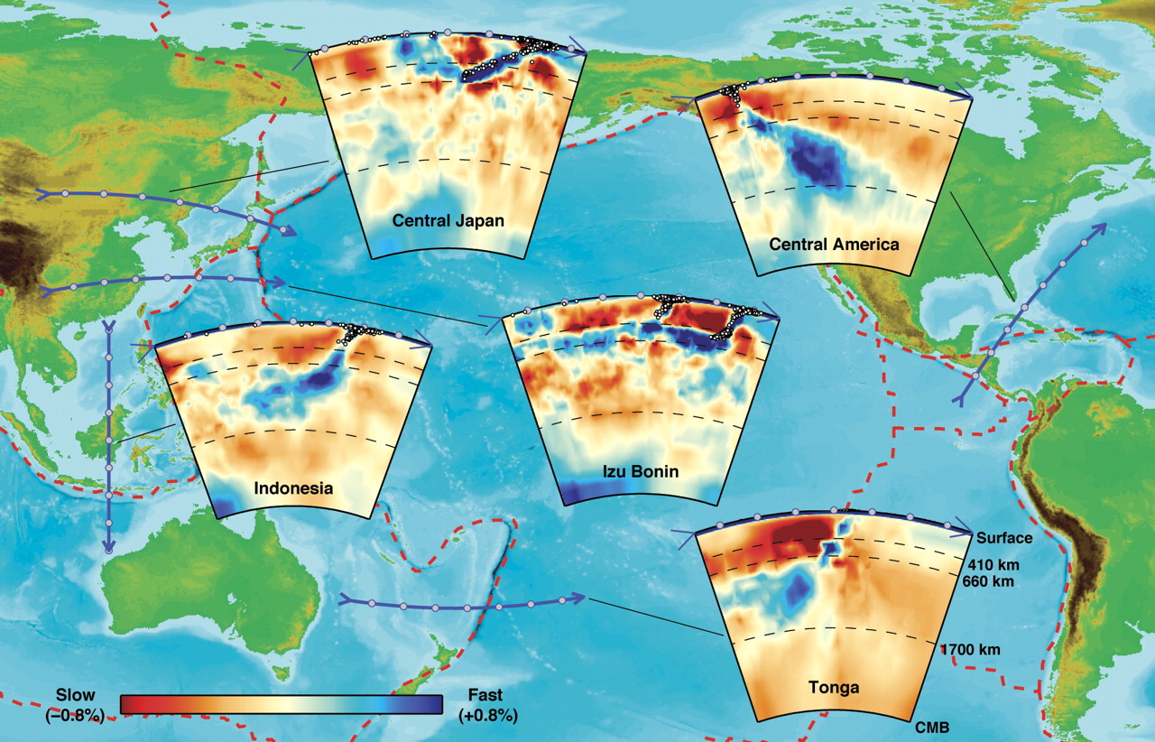
Seismic tomography of the mantle
Notes:
Earthquakes produce acoustic waves which can be felt across the globe. Tens of thousands of seismometers are deployed around the world and are continuously listening to the seismic 'heartbeat' of the Earth. By logging the arrival times of thousands of significant seismic events in thousands of seismometers, seismologists can reconstruct the 'seismic velocity structure' of the Earth's mantle. Areas characterised by relatively slow seismic velocities characterise cold mantle, whereas high velocity zones characterise relatively hot mantle. Thus, using methods that are in many ways similar to a medical CAT-scan, seismologists, can create a 'tomographic' picture of the mantle, which clearly shows the convection currents inside the Earth
Earthquakes produce acoustic waves which can be felt across the globe. Tens of thousands of seismometers are deployed around the world and are continuously listening to the seismic 'heartbeat' of the Earth. By logging the arrival times of thousands of significant seismic events in thousands of seismometers, seismologists can reconstruct the 'seismic velocity structure' of the Earth's mantle. Areas characterised by relatively slow seismic velocities characterise cold mantle, whereas high velocity zones characterise relatively hot mantle. Thus, using methods that are in many ways similar to a medical CAT-scan, seismologists, can create a 'tomographic' picture of the mantle, which clearly shows the convection currents inside the Earth.

Slide 23
Modules available in the Geology programme
Year 1
Year 2
Earth Materials
The Earth
Geochemistry
From Petrology to Petrogenesis
Dynamic Earth
Surface Processes
History of Life
Foundations of Physical Geoscience
Mathematics
Science Communication
Revealing Science
Global Geophysics
Maps, Images & Structures
Structural Geology & Tectonics
Surface Processes & Structures
Isotope Geology
Principles of Climate
Numerical Methods for Earth Sciences
Evolution in Science and Culture
Engaging the Public with Science
Vertebrate Palaeontology & Evolution
Igneous Petrology
Year 3
Year 4
Metamorphism and Metamorphic Processes
Crustal Dynamics, Mountain Building & Basin Evolution
Earth Resources & Sustainability
Groundwater Science
Marine Geology
Advanced Geochemistry
Geological/Environmental Mapping Project
Biodiversity & Macroevolutionary Studies
Seismology I
Ocean Physics and Climate Change
Geosciences Report
Geodynamics and Global Tectonics
Earth & Planetary Materials
Physical Volcanology & Volcanic Hazard
Tectonic Geomorphology
Sustainable Management of the Environment
Independent MSci Project
Earth & Planetary System Science
Earthquake Seismology & Earthquake Hazards
Palaeoceanography
Palaeoclimatology
Melting and Volcanism
Deep Earth & Planetary Modelling
Advanced Biodiversity and Macroevolutionary Studies
Notes:
The Geology programme includes studies of the nature of rocks and minerals, their mode of origin and environment of formation; the study of past life and palaeoenvironments; the physics and chemistry of the Earth and major Earth processes such as plate tectonics and mountain building (tectonics).
The Geology programme includes studies of the nature of rocks and minerals, their mode of origin and environment of formation; the study of past life and palaeoenvironments; the physics and chemistry of the Earth and major Earth processes such as plate tectonics and mountain building (tectonics). These modules are taught by people such as Professors Kevin Pickering, Juergen Thurow, David Dobson, and Graham Shields and Drs. Dominic Papineau, Tom Mitchell, Adrian Jones, Matthew Fox, Susan Little and Philip Pogge von Strandmann.

Slide 24
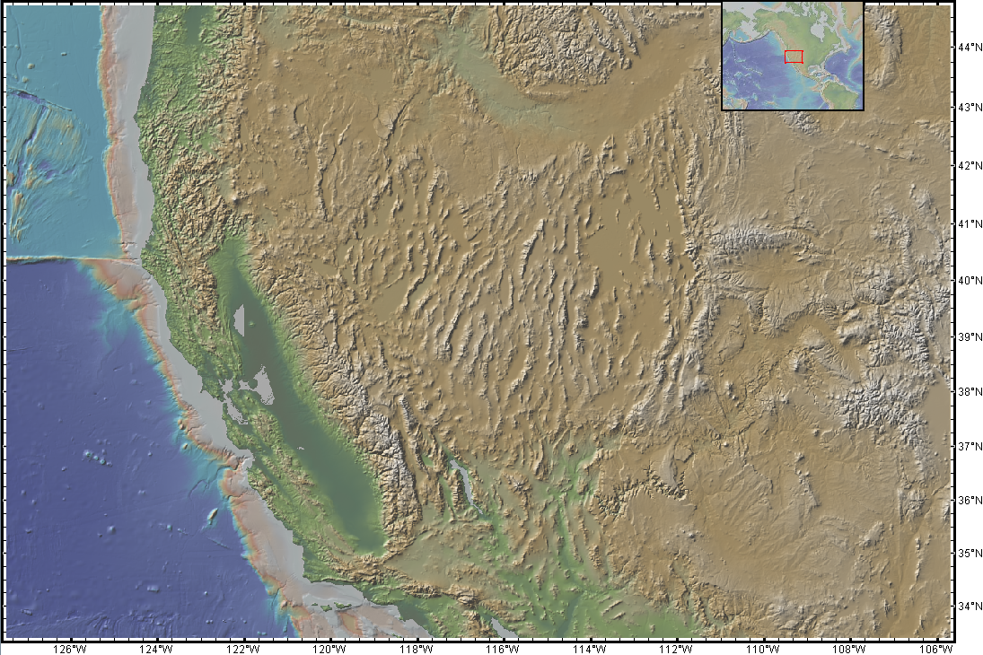
Shaded relief map of North America's 'Basin and Range'
Notes:
Geologists combine the latest methods in geochemistry and geophysics with simple but powerful field techniques, which date back to the 19th century and require nothing more than a hand lens, a geological compass/clinometer, and a hammer. Despite the simplicity of these tools, field geology continues produce major discoveries about our planet. Take, for example, the western United States (Nevada), which is characterised by a very peculiar type of topography, which features north-south trending mountain ranges separated by flat areas. This 'basin and range' topography is the surface expression a most peculiar geological phenomenon.
Geologists combine the latest methods in geochemistry and geophysics with simple but powerful field techniques, which date back to the 19th century and require nothing more than a hand lens, a geological compass/clinometer, and a hammer. Despite the simplicity of these tools, field geology continues produce major discoveries about our planet. Take, for example, the western United States (Nevada), which is characterised by a very peculiar type of topography, which features north-south trending mountain ranges separated by flat areas. This 'basin and range' topography is the surface expression a most peculiar geological phenomenon.

Slide 25
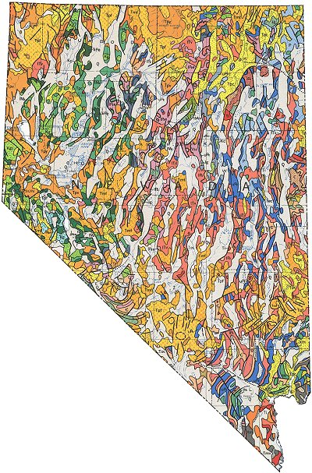
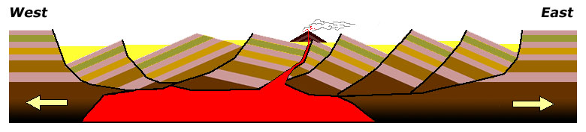
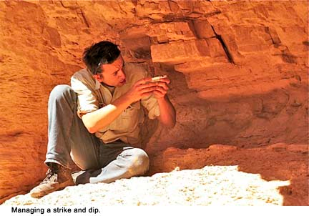
Nevada has widened >100% over the past 25 million years!
Notes:
On the left, this slide shows the geologic map of Nevada, which was created by geologists who, over the course of many years, walked all across this vast area, recording the different rock types found within it. They then marked these different groups of rocks (igneous, metamorphic, sedimentary, old, young) in different colours on a topographic map, along with the dip (tilt) of the beds and major faults (fractures) running through them. After all this work, the geologists came to the conclusion that the Basin and Range Province has been affected by more than 100% of east-west extension over the past 25 million years. In other words, the state of Nevada was only half its current size 25 million years ago. Incredible though this might seem, the geologists' conclusion was confirmed by geodetic (GPS) surveys, which indicate that the Basin and Range is indeed getting wider every year.
On the left, this slide shows the geologic map of Nevada, which was created by geologists who, over the course of many years, walked all across this vast area, recording the different rock types found within it. They then marked these different groups of rocks (igneous, metamorphic, sedimentary, old, young) in different colours on a topographic map, along with the dip (tilt) of the beds and major faults (fractures) running through them. After all this work, the geologists came to the conclusion that the Basin and Range Province has been affected by more than 100% of east-west extension over the past 25 million years. In other words, the state of Nevada was only half its current size 25 million years ago. Incredible though this might seem, the geologists' conclusion was confirmed by geodetic (GPS) surveys, which indicate that the Basin and Range is indeed getting wider every year.

Slide 26
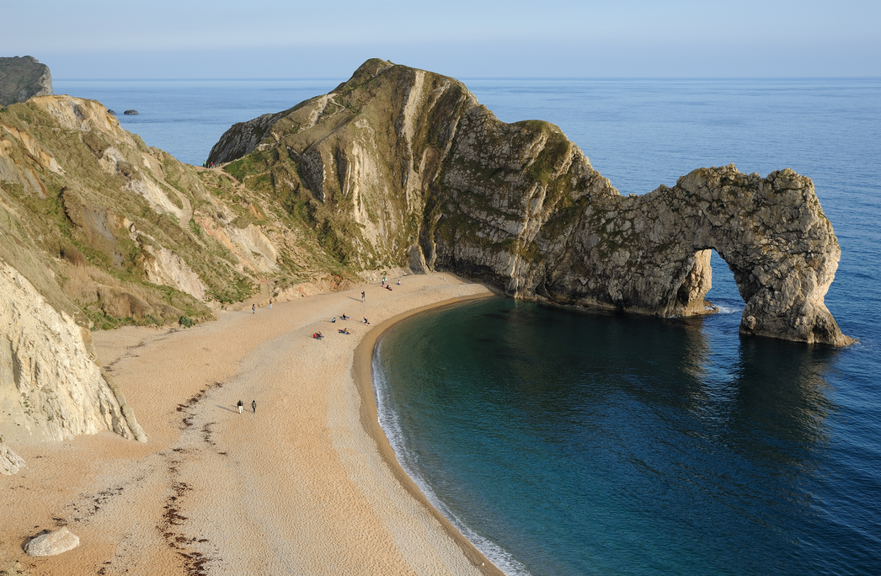
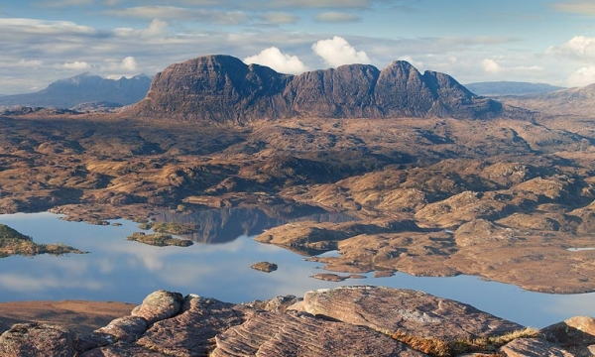
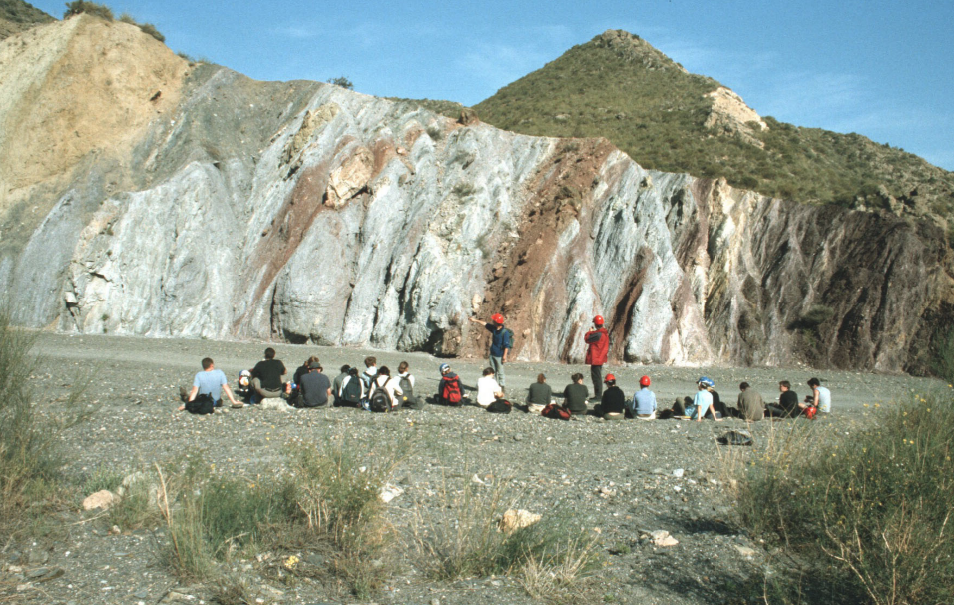
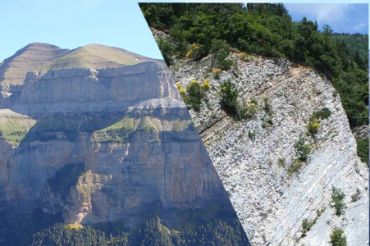
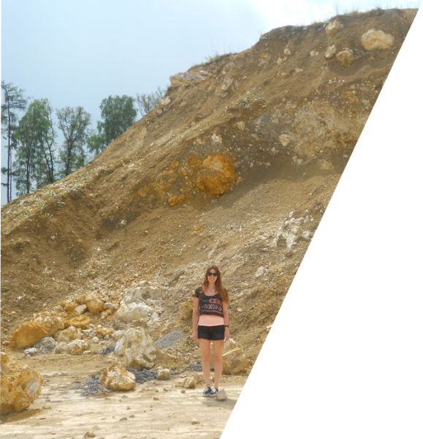
Field courses
Year 1
Year 1-2
Dorset-Cornwall
Assynt (Scotland)
Year 2-3
Year 3-4
Marche (Italy)
Riess (Germany)
Pyrenees
Betics (Spain)
Notes:
The Geology curriculum includes a very significant and rigorous field component during every year of study. The Dorset field trip has already been mentioned before. During their second year of study, Geology students spend several weeks in Scotland to sharpen their mapping skills. Various modules during the later years of study offer further field training in France, Italy, Germany and Spain.
The Geology curriculum includes a very significant and rigorous field component during every year of study. The Dorset field trip has already been mentioned before. During their second year of study, Geology students spend several weeks in Scotland to sharpen their mapping skills. Various modules during the later years of study offer further field training in France, Italy, Germany and Spain. These courses are all heavily subsidised by the Department, which completely covers the cost of lodging and local transportation.

Slide 27
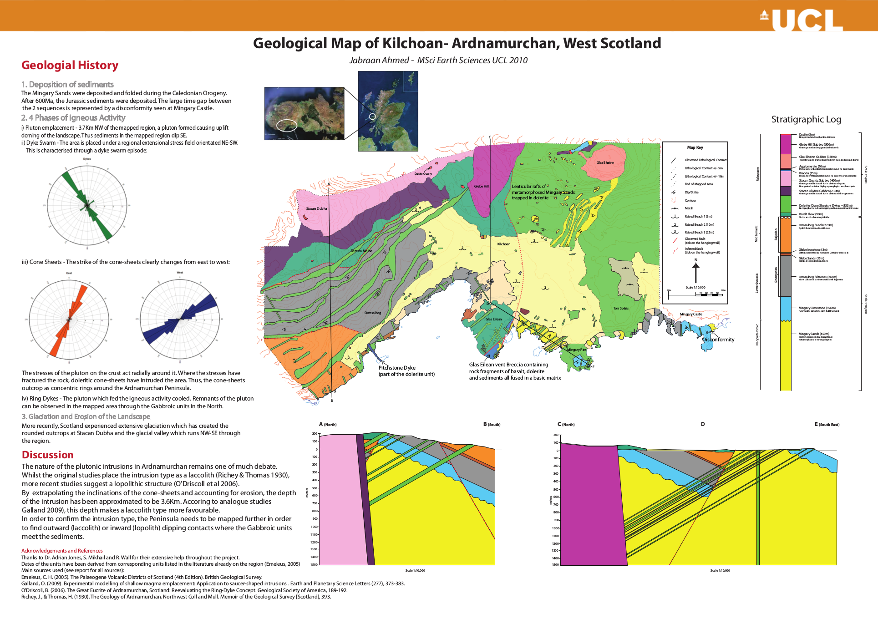
Third year mapping project
Notes:
Geology students are required to complete a mapping project during their third year of study, which may be carried out in a field area of their choosing.
Geology students are required to complete a mapping project during their third year of study, which may be carried out in a field area of their choosing. Historically this was always done in Scotland but since two years, students are also allowed to choose warmer places such as Spain or Italy.

Slide 28
Environmental Geoscience
Year 1
Year 2
Global Geophysics
Maps, Images and Structures
Structural Geology & Tectonics
Surface Processes & Structures
Isotope Geology
Principles of Climate
Vertebrate Palaeontology & Evolution
Foundations of Physical Geoscience
Mathematics
Geomorphology
Ecological Patterns & Processes
Hydroclimatology
Science in Popular Culture
Remote Sensing & Planetary Surfaces
Reconstructing Past Environments
Environmental Remote Sensing
Science & Ethics
Earth Materials
The Earth
Geochemistry
From Petrology to Petrogenesis
Dynamic Earth
Earth: An Integrated System
History of Life
Surface Processes
Year 3
Year 4
Groundwater Science
Crustal Dynamics
Earth Resources & Sustainability
Marine Geology
Advanced Geochemistry
Metamorphism and Metamorphic Processes
Geological/Environmental Mapping Project
Field Geophysics
Biodiversity & Macroevolutionary Patterns
Global Environmental Change
Geosciences Report
Earth & Planetary Materials
Physical Volcanology & Volcanic Hazard
Tectonic Geomorphology
Sustainable Management of the Environment
Earth & Planetary System Science
Independent MSci Project
Earthquake Seismology & Earthquake Hazards
Palaeoceanography
Palaeoclimatology
Advanced Biodiversity and Macroevolutionary Studies
Biological Indicators of Environmental Change
Non-Biological Indicators of Environmental Change
Notes:
Environmental Geoscience is concerned with the interaction between the Earth sciences and human activity, and provides a sound topical background in the environmental aspects of the Earth sciences.
Environmental Geoscience is concerned with the interaction between the Earth sciences and human activity, and provides a sound topical background in the environmental aspects of the Earth sciences. Environmental Sciences are another key research strength of the Department, represented by Professors Dan Osborn, Eric Oelkers, John McArthur and Julienne Stroeve, and Dr. Michel Tsamados.

Slide 29
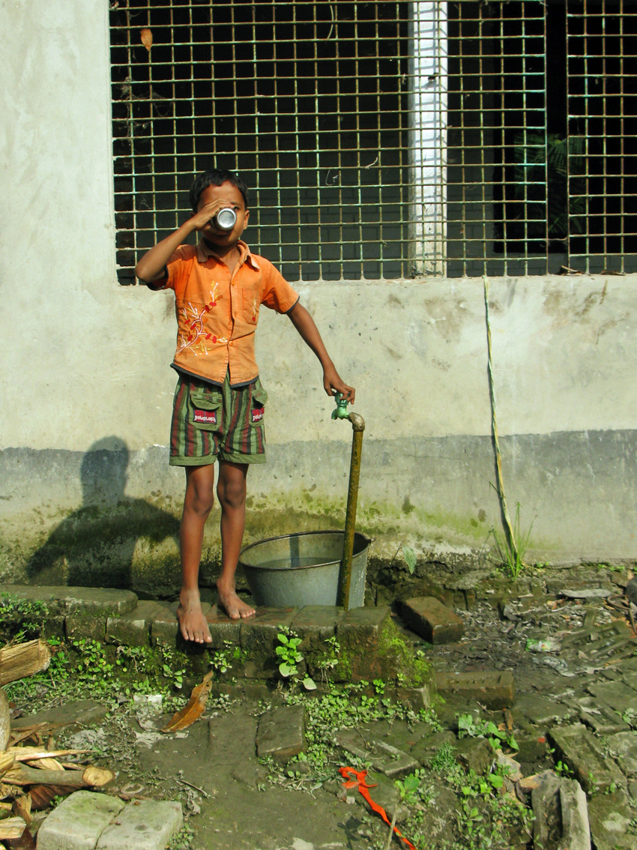
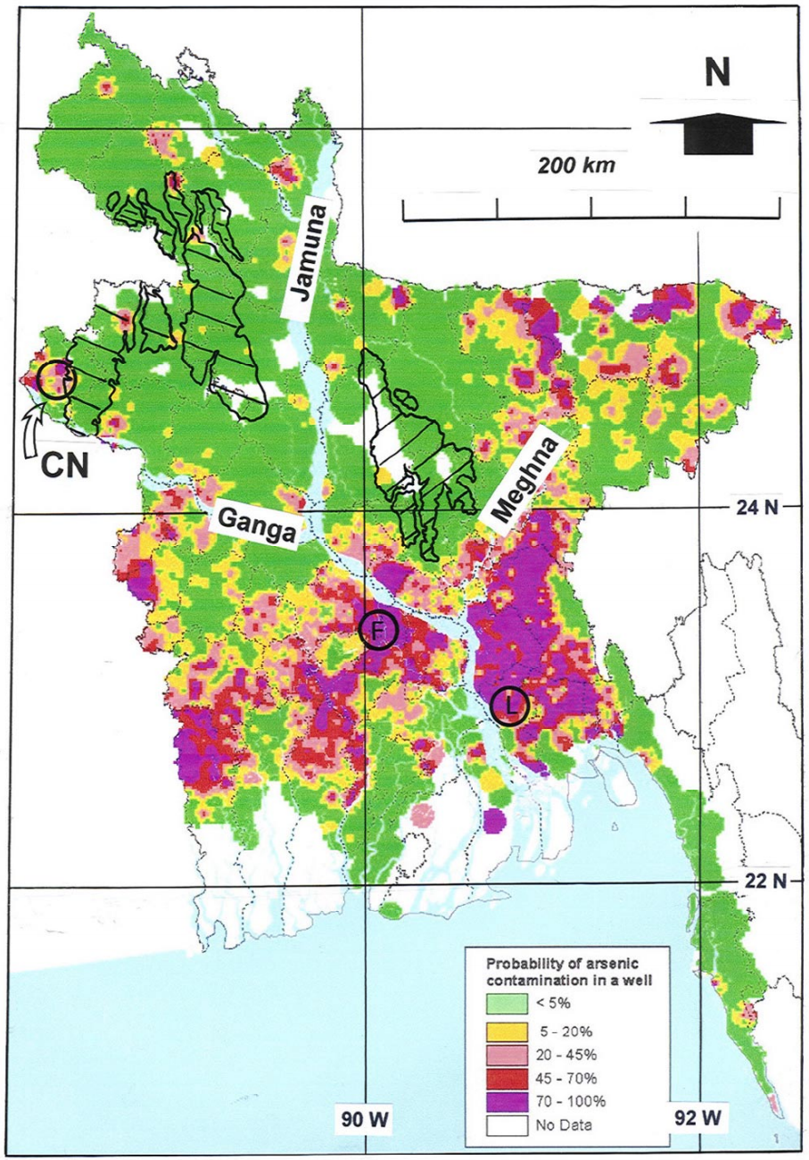
Arsenic Poisoning in Bangladesh
Notes:
Thousands of water wells in Bangladesh are contaminated with arsenic, resulting in a major health crisis. The source of the arsenic poisoning was unravelled by Professor John McArthur's research team at UCL.
Thousands of water wells in Bangladesh are contaminated with arsenic, resulting in a major health crisis. The source of the arsenic poisoning was unravelled by Professor John McArthur's research team at UCL.

Slide 30
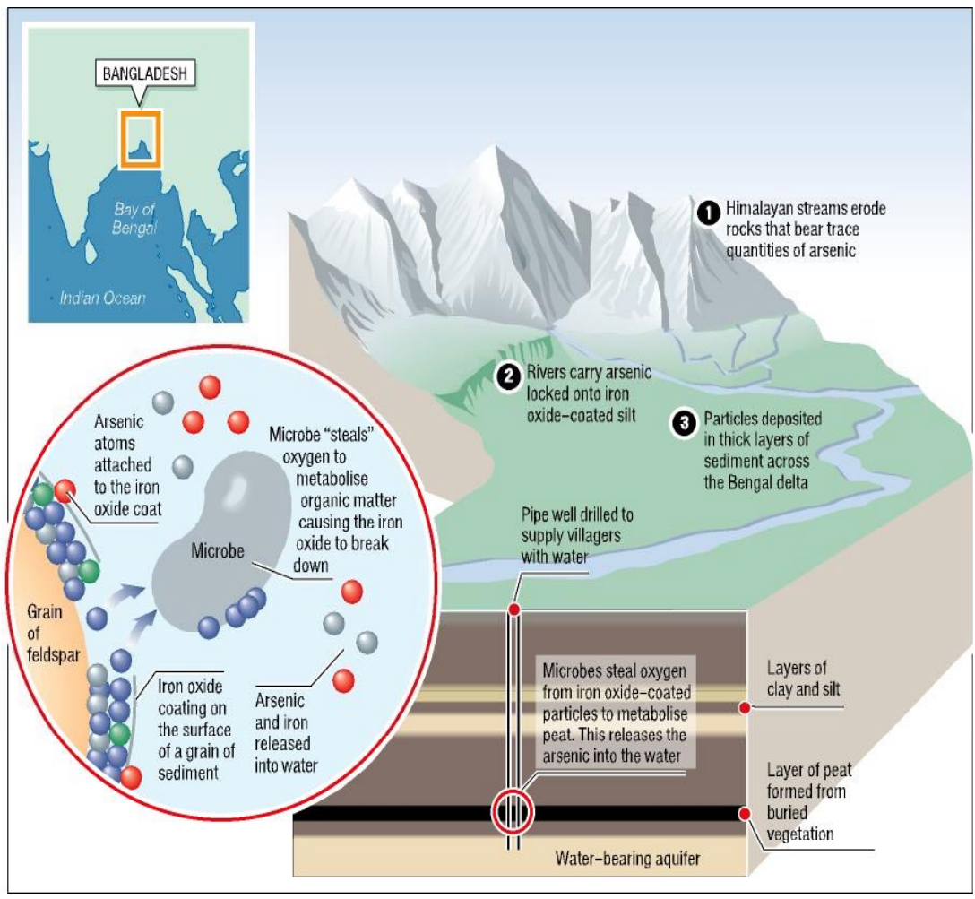
Arsenic poisoning in Bangladesh
C₆H₁₂O₆ + 6O₂
↓
6CO₂ + 6H₂O + ε
2(Fe₂O₃.As) + ε
↓
4Fe + 6O₂ + 2As
Notes:
Arsenic is found in harmlessly low concentrations in the waters of the Ganga and Brahmaputra rivers, which carry billions of tonnes of sediment from the Himalayas to the Bengal lowlands, where they are deposited in fertile marshlands. Ganga and Brahmaputra sediments contain quartz grains which are coated with a thin film of iron oxide ('rust'). Arsenic atoms are adsorbed to these thin coatings and buried in the Ganga and Brahmaputra delta along with large amounts of organic matter. It is the combination of the organic matter, the iron oxides and the arsenic which causes the arsenic poisoning. Micro organisms in the sub-surface require oxygen to digest the organic matter. Once they have used up all the oxygen in the groundwater, these microbes harvest oxygen from the iron-oxide cover of the sand grains. With no iron-oxide left to cling on to, the arsenic is released to the groundwater. Any well drilling into such an aquifer will contain potentially lethal levels of this otherwise entirely natural pollutant.
Arsenic is found in harmlessly low concentrations in the waters of the Ganga and Brahmaputra rivers, which carry billions of tonnes of sediment from the Himalayas to the Bengal lowlands, where they are deposited in fertile marshlands. Ganga and Brahmaputra sediments contain quartz grains which are coated with a thin film of iron oxide ('rust'). Arsenic atoms are adsorbed to these thin coatings and buried in the Ganga and Brahmaputra delta along with large amounts of organic matter. It is the combination of the organic matter, the iron oxides and the arsenic which causes the arsenic poisoning. Micro-organisms in the sub-surface require oxygen to digest the organic matter. Once they have used up all the oxygen in the groundwater, these microbes harvest oxygen from the iron-oxide cover of the sand grains. With no iron-oxide left to cling on to, the arsenic is released to the groundwater. Any well drilling into such an aquifer will contain potentially lethal levels of this otherwise entirely natural pollutant.
Climate change is another important environmental problem which is intensively studied at UCL's Earth Science department. The Centre of Polar Observation and Modelling (CPOM) is the control centre of the CRYOSAT-2 satellite, which continuously monitors ice thickness in the Arctic and Antarctic. CRYOSAT is the brainchild of our former Head of Department Prof. Duncan Wingham. Data produced by the satellite and processed at CPOM have precisely documented the spectacular decline of sea ice thickness in the Arctic over the past few years, which has exceeded even the most pessimistic climate change scenarios.

Slide 31
Earth Sciences
Year 1
Year 2
General Stream
Palaeobiology Stream
General
Palaeobiology
Earth Materials
The Earth
Geochemistry
Dynamic Earth
Surface Processes
Petrology to Petrogenesis
Foundations of Phys. Geosc.
Mathematics for Engineers I
Earth: An Integrated System
Quantitative Biology
Life On Earth
Revealing Science
History of Life
Maps, Images & Structures
Structural Geology & Tectonics
Global Geophysics
Surface Processes & Structures
Principles of Climate
Isotope Geology
Vertebrate Palaeontology
Geomorphology
Ecological Patterns & Processes
Hydroclimatology
Science in Popular Culture
Igneous Petrology
Past Environments
Environmental Remote Sensing
Quantitative Biology
Life on Earth
Introduction to Genetics
Revealing Science
Science & Society
History & Philosophy of Sci.
Revealing Science
Science Communication
Animal Biodiversity
Molecular Biology
Astrobiology
Evolutionary Genetics
Fundamentals of Ecology
Science in Popular Culture
Sociology of Science & Tech.
Environment and Society
Science and Ethics
Engaging the Public with Science
Environment &
Policy Stream
Environment & Policy
Year 3
Year 4
General
Palaeobiology
Earth & Planetary Materials
Physical Volcanology & Volcanic Hazard
Tectonic Geomorphology
Sustainable Management of the Environment
Independent MSci Project
Earth & Planetary System Science
Earthquake Seismology & Earthquake Hazards
Palaeoclimatology
Melting and Volcanism
Deep Earth & Planetary Modelling
Advanced Biodiversity and Macroevolutionary Studies
PalaeoceanographyVertebrate Life & Evolution
Species Conservation & Biodiversity
Metamorphic Processes
Crustal Dynamics
Earth Resources & Sustainability
Groundwater Science
Marine Geology
Advanced Geochemistry
Macroevolutionary Patterns
Ocean Physics & Climate Change
Mapping Project
Geodynamics and Global Tectonics
Global Environmental Change
Geosciences Report
Seismology I
Seismology II
Environmental Change
Palaeoanthropology
Primate Behaviour
Species Conservation
Sex, Genes and Evolution
Primate Evolution
Communication in Science
Emerging Technologies
Technology & Environment
Science Journalism
General
Palaeobiology
Environment & Policy
Notes:
Earth Sciences MSci & BSc degrees are intended as an entry route for high-level professional employment or postgraduate education. This flexible programme allows you to select from the range of options offered across environmental geoscience, geology and geophysics. You may also graduate with a degree in Earth Sciences (Palaeobiology), or in Earth Sciences (Planetary Science), dependent on your chosen courses.
Earth Sciences MSci & BSc degrees are intended as an entry route for high-level professional employment or postgraduate education. This flexible programme allows you to select from the range of options offered across environmental geoscience, geology and geophysics. You may also graduate with a degree in Earth Sciences (General), Earth Sciences (Environment & Policy), or Earth Sciences (Palaeobiology), dependent on your chosen courses. The next few slides provide some more information about the latter option.

Slide 32
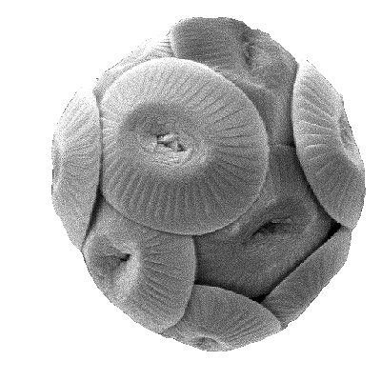
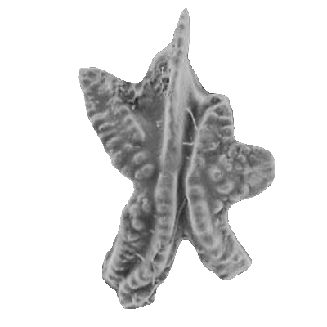
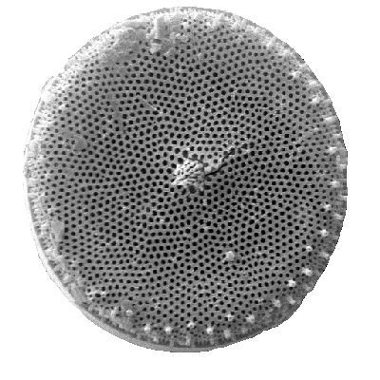
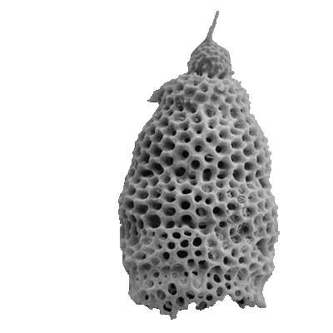
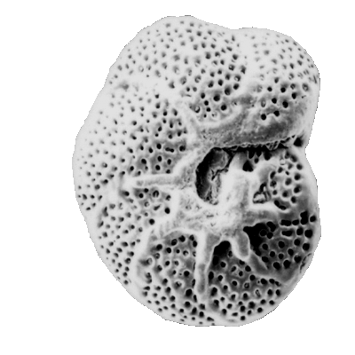
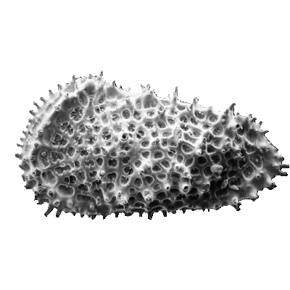
Coccoliths, conodonts, diatoms, forams, ostracods, radiolaria (clockwise)
100μm
Notes:
Whereas dinosaur fossils are very rare, microfossils are abundant. Profs. Bridget Wade and Paul Bown study the evolution of micro-organisms though geologic time by documenting the fossil content of sedimentary rocks.
The Department hosts four world leading palaeontologists including dinosaur experts Prof. Paul Upchurch and Dr. Philip Mannion, and micropalaeontologists Prof. Bridget Wade and Paul Bown.
New dinosaur species continue to be discovered in countries like China and Argentina at an increasing rate. Modern imaging technology (CT scans) allow palaeobiologists to image the inside of dinosaur eggs. Computer models can be used to simulate the forces acting on scanned dinosaur bones allowing, for the first time, to constrain the gait and speed of these long extinct species.
Whereas dinosaur fossils are very rare, microfossils are abundant. They can be found in most sedimentary rocks and can help put key constraints on the evolution of life though geologic time.

Slide 33
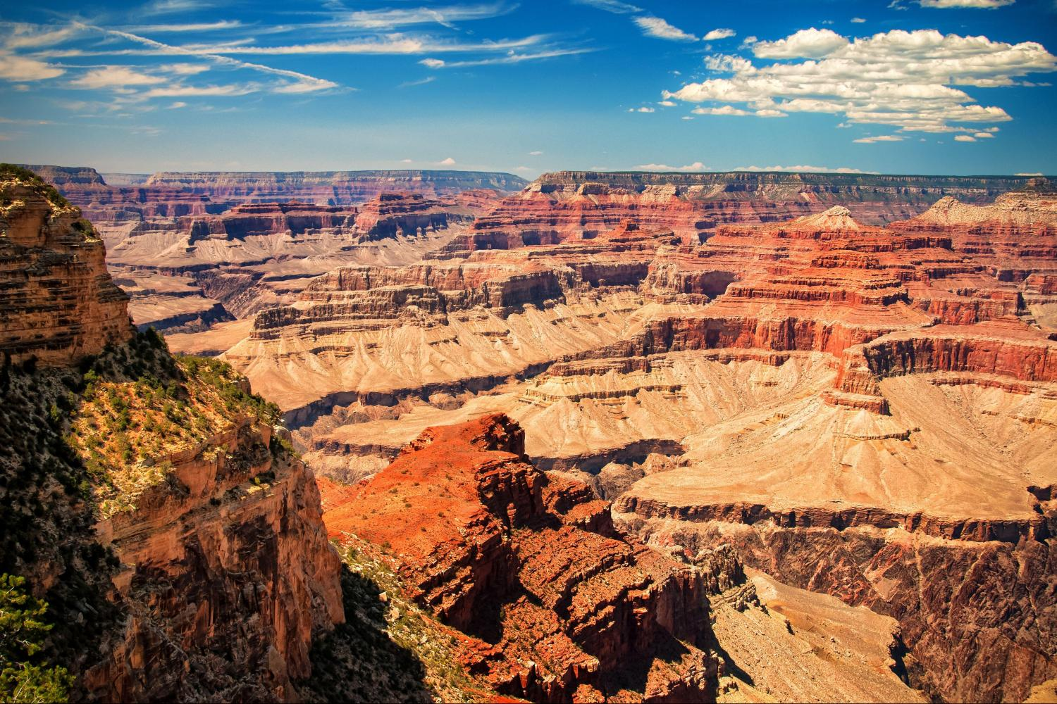
Sedimentary rocks in the Grand Canyon are full of microfossils
Notes:
Take, for example, the thick stack of sedimentary rocks exposed in the Grand Canyon, which contain abundant microfossils. The morphologies of these fossils change with time and, hence, elevation within the Grand Canyon, as a result of evolution and natural selection. Once extinct, a fossil never appears in the geologic record again. The biological evolution of micro-fossils forms the basis of a relative time scale which allows sedimentary geologists to date rocks otherwise not amenable to the radiometric techniques discussed before.
Take, for example, the thick stack of sedimentary rocks exposed in the Grand Canyon, which contain abundant microfossils. The morphologies of these fossils change with time and, hence, elevation within the Grand Canyon, as a result of evolution and natural selection. Once extinct, a fossil never appears in the geologic record again. The biological evolution of micro-fossils forms the basis of a relative time scale which allows sedimentary geologists to date rocks otherwise not amenable to the radiometric techniques discussed before.

Slide 34

“Accredited status provides added assurance to prospective
students that a department's teaching is of the highest quality.”
Notes:
Our BSc and MSci programmes in Geology, Geophysics and Environmental Geosciences are accredited by the Geological Society. These programmes are periodically inspected by the GS to confirm that they meet certain requirements (e.g., field work, mapping, quantitative skills, software skills). Having an accredited degree makes is much easier to become a Chartered Geologist/Geophysicst/Environmental Geoscientist, which is important if you want to be a freelance consultant, and useful for applying to any other geoscience-related job.
Our BSc and MSci programmes in Geology, Geophysics and Environmental Geosciences are accredited by the Geological Society. These programmes are periodically inspected by the GS to confirm that they meet certain requirements (e.g., field work, mapping, quantitative skills, software skills). Having an accredited degree makes is much easier to become a Chartered Geologist/Geophysicst/Environmental Geoscientist, which is important if you want to be a freelance consultant, and useful for applying to any other geoscience-related job.

Slide 35
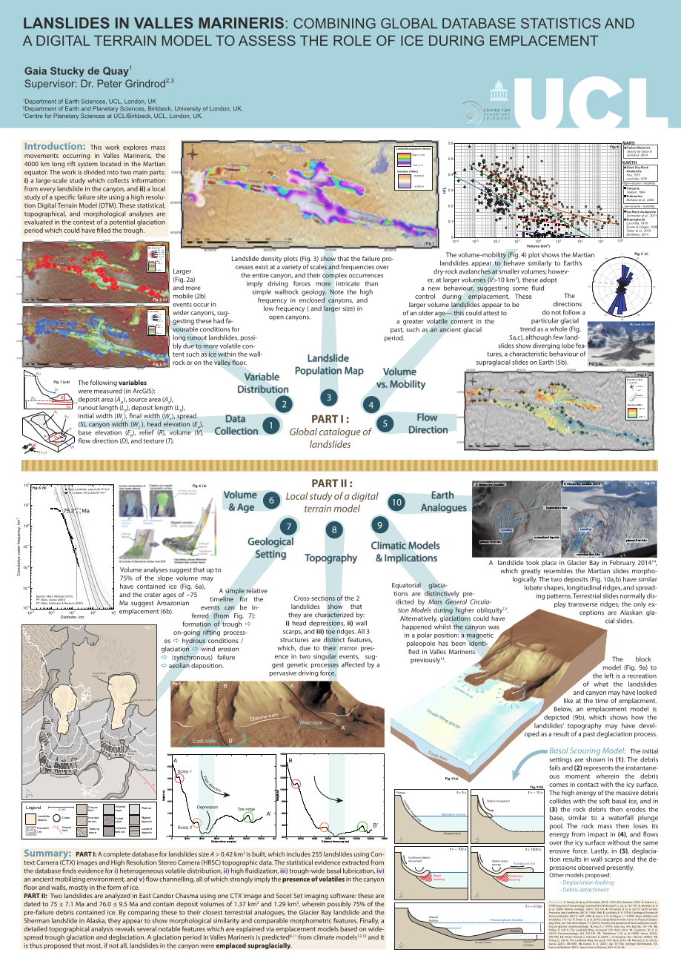

MSci 4th year independent project.
Notes:
During their fourth year at UCL, MSci students are expected to complete an independent research project under the supervision of one of our academic staff. This gives students an opportunity to take part in the cutting edge research done in the department, and gain experience in presenting this work orally and in writing.
During their fourth year at UCL, MSci students are expected to complete an independent research project under the supervision of one of our academic staff. This gives students an opportunity to take part in the cutting edge research done in the department, and gain experience in presenting this work orally and in writing.

Slide 36











MSci Earth Sciences (International Programme)
Notes:
The word 'international' is one of several words invented by Jeremy Bentham which have become part of the English language. In the spirit of Bentham's internationalism, the International Programme allows First Class MSci students to spend their third year abroad. Most students go to the United States but a plethora of other institutions are possible as well. This slide shows just a small selection of the partner institutions. Eligibility to continue to the International Programme is assessed in both the first and the second years of study. Students failing to maintain the required standard are transferred to the corresponding normal MSci or BSc programme.
The word 'international' is one of several words invented by Jeremy Bentham which have become part of the English language. In the spirit of Bentham's internationalism, the International Programme allows First Class MSci students to spend their third year abroad. Most students go to the United States but a plethora of other institutions are possible as well. This slide shows just a small selection of the partner institutions. Eligibility to continue to the International Programme is assessed in both the first and the second years of study. Students failing to maintain the required standard are transferred to the corresponding normal MSci or BSc programme. The year abroad is not only rewarding personally and academically, but financially as well. During your year abroad your fees at UCL will be reduced, and you will not need to pay tuition fees to the overseas institution. We now allow students from any of our programmes to switch to the International Programme during the first or second year of study. So if you find that you are doing well during your first year, this is an option that you should certainly consider!

Slide 37

http://www.ucl.ac.uk/prospective-students/undergraduate/fees-funding
Fees: £9,250/year (UK/EU tax payers)
Overseas students: £25,960
Maintenance loans: Max. £11,002/year
Low income households:
UCL Undergraduate Bursaries
Scholarships, Prizes and Awards
Study Abroad Financial Assistance
Access to Learning Fund
Student Hardship Fund
Disabled Students Allowance
See website for further information
Notes:
UCL, like most English universities, charges £9,000 tuition per year, in the form of a government loan which is to be paid off after graduation once the graduate earns enough money to afford it. Additional loans are available to cover other costs such as housing, books and food. Students from low income households are eligible for financial support from the University. Many other sources of financial support are available, as document on the Finance Department's website.
UCL, like most English universities, charges £9,250 tuition per year, in the form of a government loan which is to be paid off after graduation once the graduate earns enough money to afford it. Additional loans are available to cover other costs such as housing, books and food. Students from low income households are eligible for financial support from the University. Many other sources of financial support are available, as document on the Finance Department's website.

Slide 38






All first year students are guaranteed UCL accommodation
https://www.ucl.ac.uk/residences
Notes:
UCL offers on-campus housing to all our first year students (provided they apply in time). This housing includes both fully catered and self catered accommodation.
UCL offers on-campus housing to all our first year students (provided they apply in time). This housing includes both fully catered and self catered accommodation. Living on-campus is a great way to make friends in other departments. I would recommend it even if you already live in London.

Slide 39


All but two halls of residence are <15min walk from the Department
Notes:
All UCL residences are either located in Bloomsbury, within walking distance of the campus, or near Underground lines directly connected to UCL.
All UCL residences are either located in Bloomsbury, within walking distance of the campus, or near Underground lines directly connected to UCL.

Slide 40

The major advantage of living in London: lots of choice!
Notes:
After the first year, students generally live off campus, often sharing apartments and houses throughout London. Being a really big city, London has lots of choice in accommodation at any time of the year.
After the first year, students generally live off campus, often sharing apartments and houses throughout London. Being a really big city, London has lots of choice in accommodation at any time of the year.

Slide 41




>250 clubs and student groups
Bloomsbury Theatre
Notes:
UCL offers lots of extracurricular activities, in addition to being located in the entertainment capital of the UK (and Europe). Facilities are provided for a wide range of sporting interests. The UCL Sports Grounds (St Albans, Hertfordshire) offer over 90 acres of grounds. The Bloomsbury Fitness Centre, located on the main campus, houses a variety of equipment and fitness classes. 50 different sports clubs are run under the auspices of UCL Union and Somers Town Sports Centre provides indoor facilities. The University features over 250 student clubs and groups, including ethnic and religious organisations and every special interest one can imagine.
UCL offers lots of extracurricular activities, in addition to being located in the entertainment capital of the UK (and Europe). Facilities are provided for a wide range of sporting interests. The UCL Sports Grounds (St Albans, Hertfordshire) offer over 90 acres of grounds. The Bloomsbury Fitness Centre, located on the main campus, houses a variety of equipment and fitness classes. 50 different sports clubs are run under the auspices of UCL Union and Somers Town Sports Centre provides indoor facilities. The University features over 250 student clubs and groups, including ethnic and religious organisations and every special interest one can imagine.

Slide 42





















Some recent graduates
http://ucl.ac.uk/careers
PhD (Bristol)
MRes Photonics (UCL)
Perenco Oil & Gas
Parsons Brinckerhoff
Iona Energy
BP
Graduate Trainee
(Imperial College)
Schlumberger
PhD (UCL)
Imperial College
Town and Country
Planning Association
PhD (Oxford)
Lafarge Aggregates
ESA
Neftex Petroleum
Environment Agency
Teacher
EDF Energy
Bristol University
Network Rail
Notes:
A high proportion of our graduates (30 – 50%) go on to further study (Ph.D., M.Sc. Etc.) The remainder enter a wide variety of careers. The UCL Career Centre (www.ucl.ac.uk/careers) provides career advice and organises frequent job fairs where students can meet potential employers and apply for summer internships.
A high proportion of our graduates (30 – 50%) go on to further study (Ph.D., M.Sc. Etc.) The remainder enter a wide variety of careers. The UCL Career Centre (www.ucl.ac.uk/careers) provides career advice and organises frequent job fairs where students can meet potential employers and apply for summer internships.

Slide 43









London offers many opportunities for internships
Notes:
One of the many advantages of living and studying in London is the proximity of the university to many potential employers. A large number of geoscience-related companies and organisations are based in London. This slide lists a few of these which have recently offered internships to our students.
One of the many advantages of living and studying in London is the proximity of the university to many potential employers. A large number of geoscience-related companies and organisations are based in London. This slide lists a few of these which have recently offered internships to our students.

Slide 44

Questions?
Notes:
If you have any questions, please do not hesitate to email me at p.vermeesch@ucl.ac.uk

